Slide 1
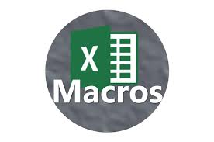
Macros

Slide 2
Macros
Macros in Excel are a powerful tool used to automate repetitive tasks. They are essentially sequences of instructions that can be recorded or written in VBA (Visual Basic for Applications), allowing users to perform tasks automatically with just a few clicks.

Slide 3
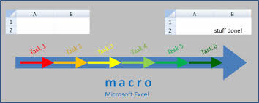
Key Features of Macros:
VBA Scripting: For more advanced automation, users can write custom macros using VBA, Excel's programming language. This allows for greater control over what the macro does.
Automation: Macros help automate tasks such as formatting data, creating reports, and performing complex calculations that would otherwise require multiple steps.
Recording Macros: Excel has a feature that allows users to record their actions as a macro without needing to write code.

Slide 4

Key Features of Macros:
VBA Scripting: For more advanced automation, users can write custom macros using VBA, Excel's programming language. This allows for greater control over what the macro does.
Assigning to Buttons: Once a macro is created, it can be assigned to buttons or shortcuts to make it easily accessible.
Security: Macros can be potentially harmful if they come from untrusted sources, so Excel provides settings to disable or enable macros with warnings.

Slide 5
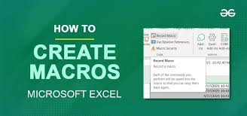
How to Create a Macro in Excel:
.
1.Record a Macro:
Go to the VIEW tab or the DEVELOPER tab (if enabled) in Excel.
Click on Record Macro
Perform the actions you want to automate.
Click Stop Recording once done.

Slide 6

2. Writing a Macro with VBA
Press Alt + F11 to open the VBA editor.
Insert a new module and write your VBA code.
Save your work and run the macro through the editor or assign it to a button in Excel.

Slide 7
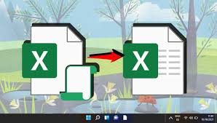
3. Managing Macros:
Run a Macro: You can run a macro by navigating to the View or developer tab and selecting Macros
Edit a Macro: To edit an existing macro, press Alt + F11 to open the VBA editor and find the macro in the list.
Enable Macros: You may need to enable macros in your Excel settings, especially if they are disabled for security reasons.

Slide 8
Conclusion
In conclusion, macros in Excel offer a powerful way to automate repetitive tasks, making it easier to handle large datasets and complex processes with minimal manual effort. By allowing users to either record simple actions or write advanced VBA code, macros enhance efficiency and accuracy in day-to-day operations. With proper understanding and cautious use of security settings, macros can significantly boost productivity, helping users save time and reduce errors.

Slide 9
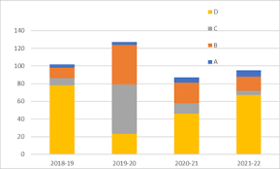

Thank you !!!
ajaycraju98@gmail.com

